Slide 1
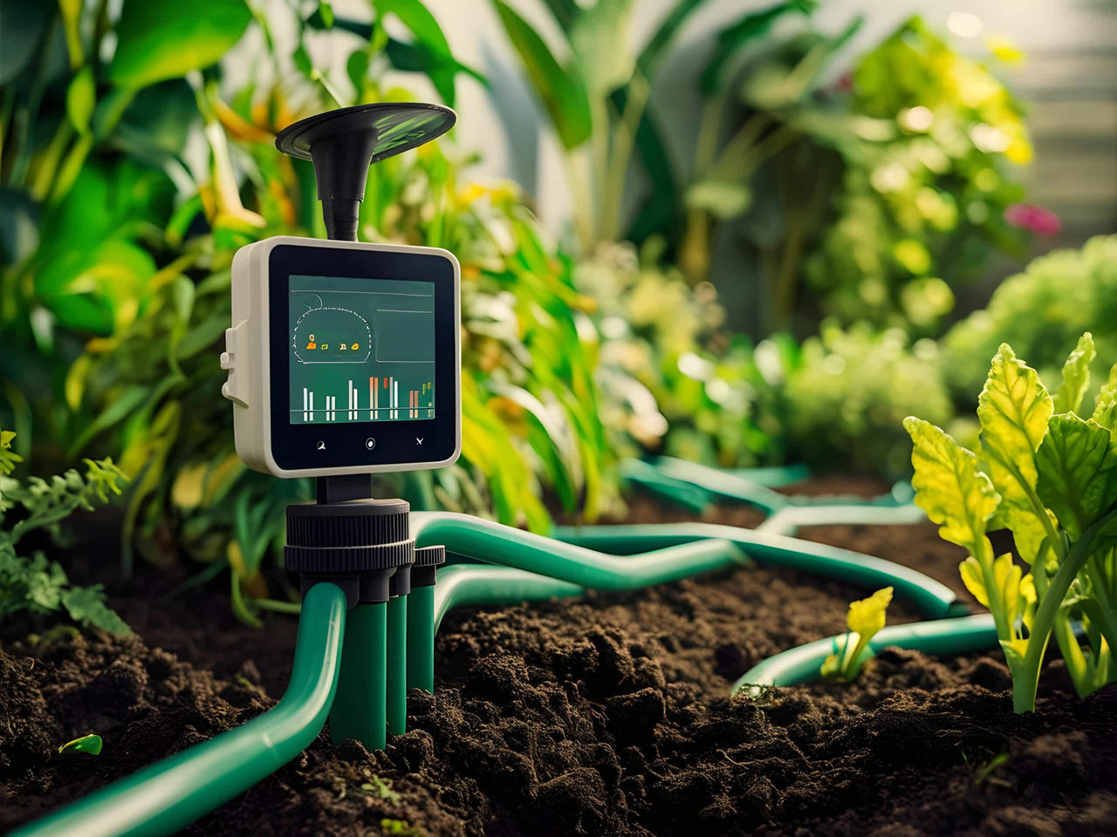
Smart Irrigation
&
Water Conservation System
Presented by Sayantika Banik, Tanvi Pardeshi and Shreya Deshpande

Slide 2
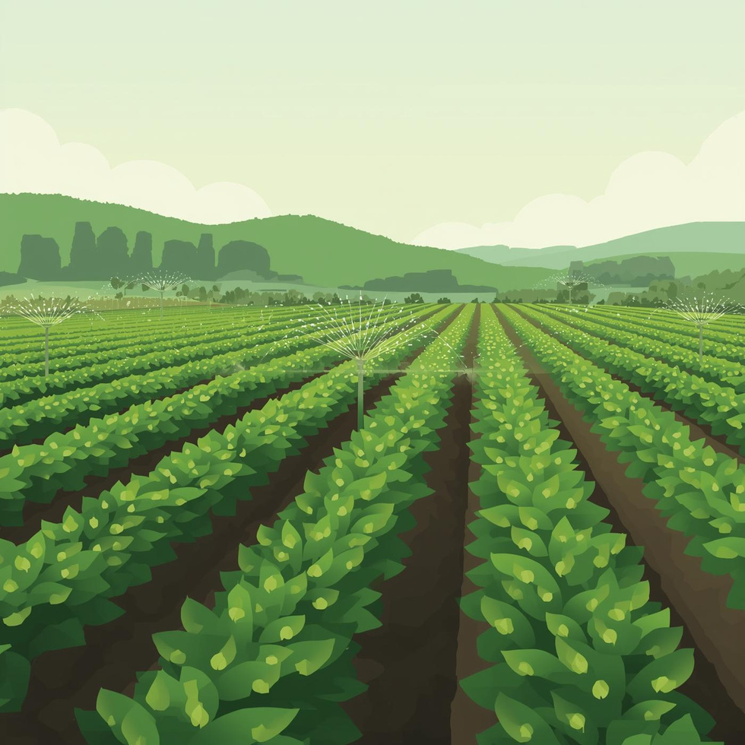
Introduction
Agriculture consumes ~70% of the world’s freshwater.
Traditional irrigation methods waste water due to fixed timing and lack of adaptability.
There is a growing need for data-driven, automated irrigation systems.
The system uses IoT sensors, Artificial Neural Network (ANN), and Fuzzy Logic for intelligent decision-making.
Goal: To ensure optimal irrigation, water conservation, and sustainable farming.

Slide 3
Problem Statement
Manual irrigation leads to overwatering or under-watering.
Systems fail to consider real-time soil and weather variations.
Excess water use causes soil erosion and power wastage.
Farmers lack automation and continuous monitoring tools.
Hence, a Smart Irrigation System is proposed for precise, automated water management.

Slide 4
Literature Survey
Existing Works and Findings:
P. Sharma, R. Kulkarni, and A. Deshmukh, “ANN-based irrigation decision support system using climatic parameters,” International Journal of Smart Agriculture, vol. 5, no. 3, pp. 45–52, 2023.
M. Hossain and S. Ferdous, “Hybrid ANN–fuzzy irrigation controller for adaptive water management,” IEEE Transactions on Agro-Technology, vol. 12, no. 1, pp. 88–96, 2024.
J. Park and S. Lee, “Weather-driven irrigation scheduling using cloud-based ANN models,” Journal of Environmental Computing, vol. 7, no. 2, pp. 134–142, 2023.
R. Gomez, L. Hernandez, and M. Ortega, “A dashboard-oriented smart irrigation model using neural computation,” Springer Journal of Intelligent Farming Systems, vol. 9, no. 1, pp. 55–67, 2024.
K. Rahmani, N. Fard, and S. Yazdi, “Fuzzy soil moisture interpretation for climate- responsive irrigation,” International Journal of Soft Computing in Agriculture, vol. 6, no. 2, pp. 74–81, 2025.
S. Chaudhary and R. Verma, “ANN simulation model for irrigation scheduling without IoT sensors,” Journal of Digital Agriculture Engineering, vol. 4, no. 1, pp. 23–30, 2023.
T. Adebayo, U. Musa, and C. Ibrahim, “Rainfall-aware ANN irrigation advisory system for monsoon regions,” IEEE Smart Farming Letters, vol. 3, no. 4, pp. 102–108, 2024.

Slide 5
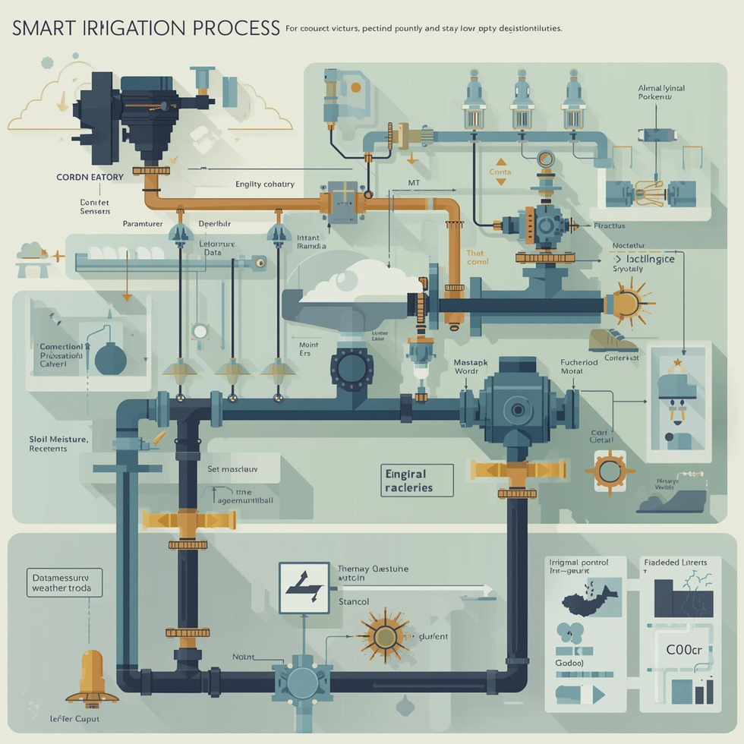
Objectives
Monitor real-time soil and environmental parameters (moisture, humidity, temperature, rainfall).
Use ANN and fuzzy logic for intelligent decision-making.
Automate irrigation control through pumps/valves.
Reduce human effort, water waste, and energy use.
Contribute to sustainable agriculture and smart farming.

Slide 6

User Inputs (City, Crop, Soil)
Process Flow Diagram
Fetch Real-time Weather API (Temp, Humidity, Rain, Wind)
Soil Moisture Estimation Model
Fuzzy Moisture Classification
(Dry/ Moderate/ Wet)
ANN Irrigation Decision Engine (Weighted Inputs + Sigmoid Output)
Final Irrigation Decision (ON/OFF)
Dashboard Output + Water Savings

Slide 7
Methodology
Forward Propagation
01
Data Collection
04
Inputs are passed through weighted neurons and activation functions to predict irrigation needs.
Using Sensors placed in fields to collect data like soil moisture and temperature
Data Preprocessing
Error Computation & Training
02
05
Cleaning Data to remove noise and inconsistensies, and normalizing data for misssing or abnormal values
The network calculates output error and adjusts weights through backpropagation to improve accuracy.
Neural Network Design Architecture
Testing & Evaluation
03
An ANN model is structured with input, hidden, and output layers to learn irrigation patterns.
06
The trained model is tested with new data to measure accuracy, water efficiency, and reliability.

Slide 8
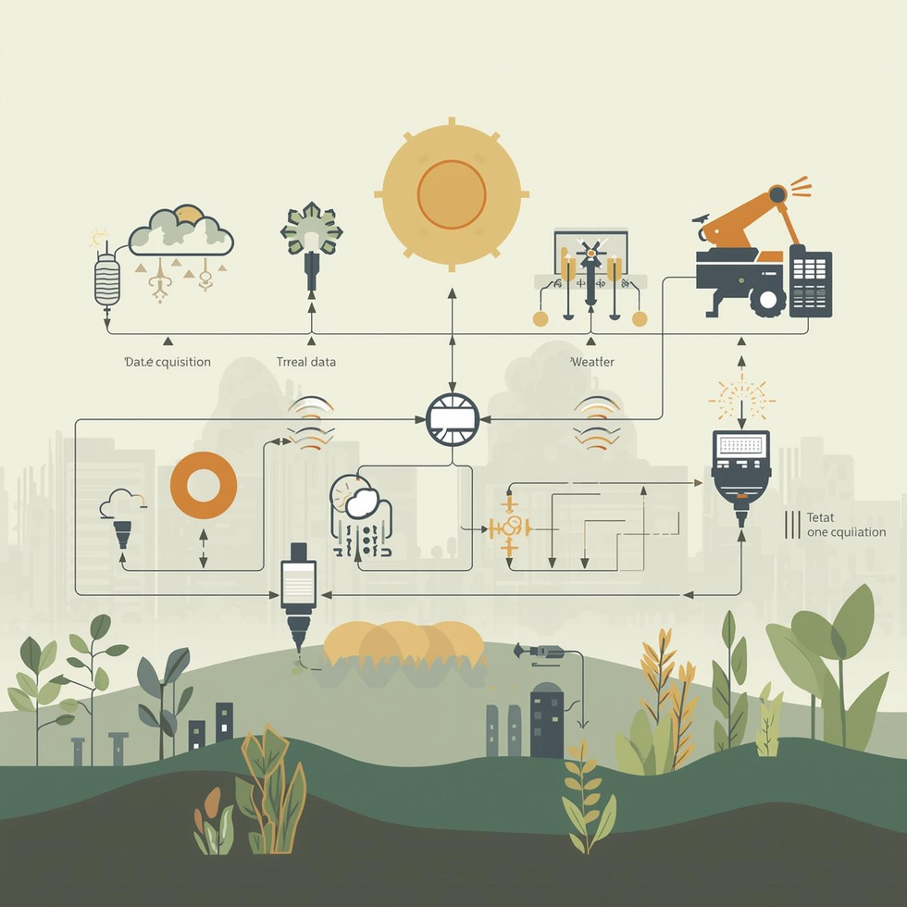
Description
The neural network for the smart irrigation system is designed to predict when and how much to irrigate based on inputs like soil moisture, temperature, humidity, rainfall, and sunlight. The collected sensor data is preprocessed and fed into a feedforward neural network with two hidden layers using ReLU activation function and an output layer using sigmoid. The model is trained using backpropagation, then evaluated for accuracy before being deployed to automate irrigation based on real-time conditions.

Slide 9

Result
The system efficiently monitored soil moisture, temperature, and humidity in real time.
Automatic irrigation was triggered only when soil moisture dropped below the optimal level.
Water usage was reduced by approximately 40–50% compared to traditional irrigation methods.
Crop growth and soil health improved due to consistent moisture control.
Manual intervention and labor costs were significantly minimized.

Slide 10
25%
30%
15%
Water Usage Reduction
Irrigation Efficiency Improvement
Crop Yield Impact

Slide 11
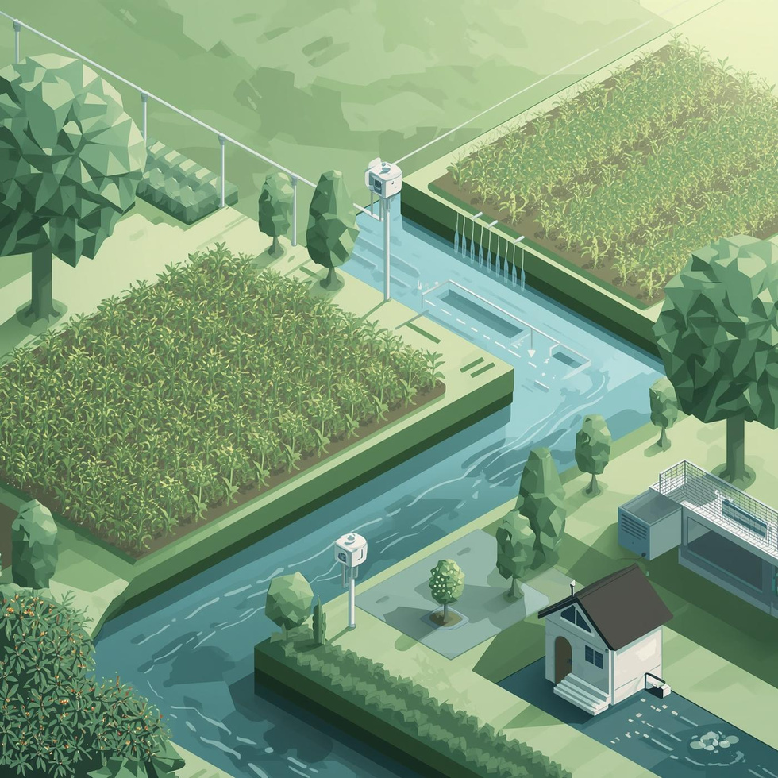
Conclusion
The Smart Irrigation and Water Conservation System provides an intelligent and automated solution for modern agriculture.
It contributes to sustainable water management, energy savings, and enhanced agricultural productivity.
The project demonstrates how technology can support eco-friendly and resource-efficient farming.

Slide 12
Thank You !

